Slide 1
Semantic Matchmaking Algorithm
Marko Lazić 3335/2011
marko.lazic88@gmail.com
Department of Computer Engineering and Computer Science,
School of Electrical Engineering,
University of Belgrade

Slide 2
Introduction
/10
The ability to dynamically discover and invoke a Web Service is a critical aspect of Service Oriented Architectures
In order to overcome the limitations of a syntax-based search, matchmaking algorithms
originally proposed by M. Paolucci

Slide 3
Algorithm
/10
The algorithm takes a OWL-S Query from the client as input
Iterates over every OWL-S Advertisement in its repository in order to determine a match
An Advertisement and a Query match if their Outputs and Inputs match
The algorithm returns a set of matching advertisements sorted according to the degree of match

Slide 4
Algorithm(2)
/10
Let Queryout and Advtout represent the list of output concepts of the Query and Advertisement respectively
Matching the outputs requires the matching between two concept-lists, Queryout and Advtout

Slide 5
Algorithm(3)
/10
Let Queryin and Advtin represent the list of input Concepts of the Query and Advertisement respectively.
Matching the inputs requires:

Slide 6
Degrees of match (1)
/10
Four degrees of match are defined between a them:
Exact:
If outA is an equivalent concept to outQ or outA is a superclass of outQ
In case of a superclass relationship, it is assumed that the service provider has agreed to support every possible subclass of outA
Plugin:
If outA Subsumes outQ
The relation between outA and outR is weaker as compared to the previous case since subsumption is indirectly inferred by the reasoner
It is assumed that the provider has agreed to support some sub-concepts of outA
We hence infer that outA can be plugged in place of the required outR

Slide 7
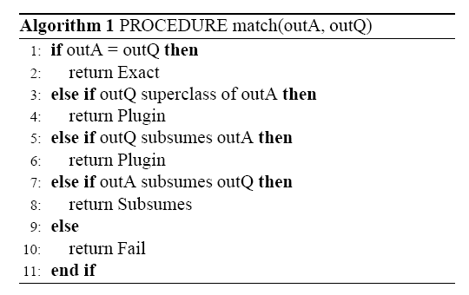
Degrees of match (2)
/10
Subsume
If outQ Subsumes outA
The set of individuals defined by the concept, outA, is a subset of the set of individuals defined by the concept outR
Fail: If none of the above conditions are satisfied

Slide 8
Conclusion
/10
outcome of the matchmaker depends on the order of the concepts in the Query
Semantic matchmaking should be agnostic of the syntactic ordering of the concepts in the Advertisements and Queries
instead of the greedy approach adopted by this algorithm there could be made better approach

Slide 9
References
/10
[1] JENA: Java Framework for Building Semantic Web Applications. http://jena.sourceforge.net/.
[2] MINDSWAP: Maryland Information and Network Dynamics Lab Semantic Web Agents Project, OWL-S API. http://www.mindswap.org/2004/owl-s/api/.
[3] North American Industry Classification System. http://www.naics.com/.
[4] OWL-S Service Retrieval Test Collection. Version 2.1. http://projects.semwebcentral.org/projects/owls-tc/.
[5] Pellet: An OWL DL Reasoner. http://pellet.owldl.com/.
[6] Protege: Ontology Editor and Knowledge-base framework. http://protege.stanford.edu/.
[7] RacerPro: OWL Reasoner and Inference Server for the Semantic Web. http://www.racer-systems.com/.
[8] Universal Description Discovery and Integration (UDDI). http://uddi.org/.

Slide 10
Questions?
/10
Marko Lazić(marko.lazic88@gmail.com)
Department of Computer Engineering and Computer Science,
School of Electrical Engineering,
University of Belgrade

